Slide 1
Teaching of Mother Languages in Exile Characteristics, Challenges, and Solutions
Dr. Abdul Ghafoor Liwal

Slide 2
The Mother Tongue Is Not an Abstract Phenomenon
For Afghans living in exile, learning the mother tongue is not just a linguistic need; it is an intellectual and spiritual foundation of identity, history, and self-awareness. It represents an effort to seek answers about one’s cultural and historical roots.

Slide 3
Language Teaching — For Whom?
In exile, especially in European countries, two main groups need to learn their mother tongue:
1. Children, adolescents, and youth.
2. Adults over 18 who were born and raised in host countries.

Slide 4
Language-Related Questions
Children and young Afghans in exile face identity questions such as:
Who am I?
Why am I here?
What are my differences with locals?
These require knowledge of Afghanistan’s history, culture, literature, and geography, which should be integrated into language learning.

Slide 5
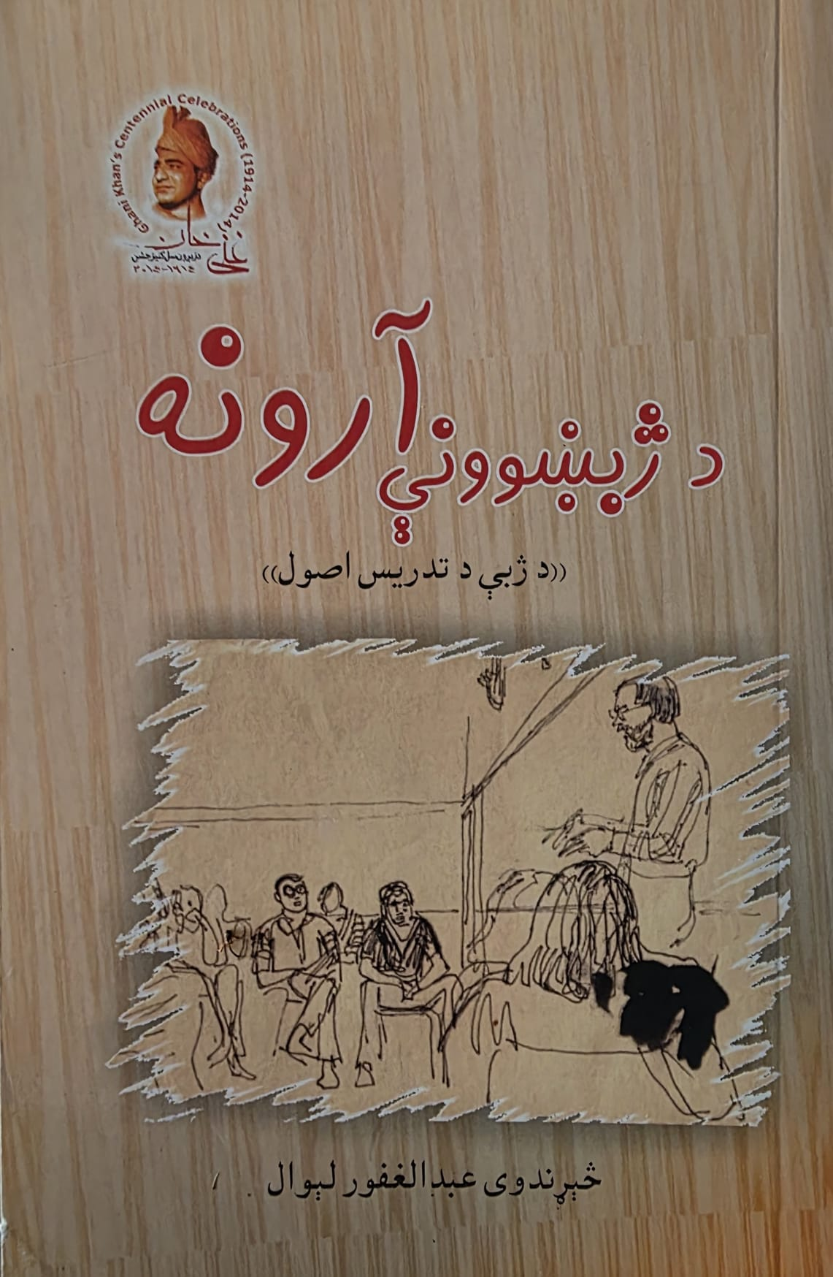
Characteristics of Mother Language Teachers
Teachers must master the target language, know its structure, history, and literature, and understand pedagogical principles and language-teaching methodologies.

Slide 6
Curriculum Challenges in Afghanistan
The biggest issue is the lack of a scientific, modern, and effective curriculum.
Existing ones (in Afghanistan) lack research-based development, professional authorship, and multimedia content such as audio, video, and visuals.

Slide 7
Curriculum for Afghans in Exile
No standardized curriculum yet exists. Each category of learners needs a tailored one, focusing on listening, speaking, reading, and writing, using multimedia and student-centered approaches.

Slide 8
The Curriculum Should Not Be Abstract
Language learning should integrate literature, history, culture, patriotism, emotional connections, and national identity.

Slide 9
Recommendations for Curriculum Development
Texts should be produced in written, audio, and visual forms to make learning accessible for all. Separate materials for children and adults are suggested.

Slide 10
Types of Curriculum Texts
Four main types: written texts, visual materials (images, videos), audio materials, and writing practice texts.

Slide 11
Methodology
Modern language teaching integrates listening, speaking, reading, and writing simultaneously, using communicative and student-centered methods with cultural content and authentic materials.

Slide 12
Course Structure
1st Book: Basic letters and words
2nd Book: Intermediate dialogues and grammar
3rd Book: Social topics and writing
4th Book: Advanced language skills and professional communication.

Slide 13
Language Teachers
Early-level teaching is preferably done by female teachers for pedagogical reasons. Teachers should understand linguistics, teaching methodology, and Afghan culture.

Slide 14
Teaching Environment
Understand the difference between cultural and instructional contexts. In-person and online learning require visual interaction and collaborative participation.

Slide 15
Teaching Materials
Curriculum books, notebooks, pens, boards, audio-visual tools, and maps are essential.

Slide 16
Supporting Activities
Dialogues, storytelling, poetry, music, films, alphabet games, writing exercises, and exhibitions.

Slide 17
Recommendations
1. Establish a responsible organization for mother tongue teaching in exile.
2. Develop and publish a standardized curriculum.
3. Train teachers.
4. Print and distribute materials.
5. Implement structured evaluation systems.

Slide 18
Thank You

