Slide 1



Practical Strategies and Lesson Ideas-Kamran Mangal
Enhancing the Quality of Teaching and Learning Materials in Mother Languages for Afghan Adult Learners in Europe
ERASMUS+ 2024-1-AT01-KA210-ADU-000250093
Funded by the European Union. The views and opinions expressed are, however, those of the author(s) only and do not necessarily reflect those of the European Union or OeAD-GmbH. Neither the European Union nor the granting authority can be held responsible for them.
advisa Unternehmensberatung GmbH © 2026 by Cornelia H.Lehmann is licensed under CC BY-NC 4.0. To view a copy of this license, visit https://creativecommons.org/licenses/by-nc/4.0/

Slide 2

1. Culturally Relevant Content
Use Afghan stories, proverbs, and traditions.
Include topics like family, work, and migration.
Compare Afghan and host-country customs.
Highlight Afghan values: hospitality, respect, perseverance.
  💡 Lesson Example: Discuss a short Afghan story about helping neighbors and compare community support in the host country.
  Learners describe Afghan recipes in the target language, then learn local ones.

Slide 3
2. Adult-Centered Approach
Focus on real-life tasks (e.g., doctor visits, job search).
Let learners choose topics and pace.
Connect learning to personal experiences.
  💡 Lesson Example: Fill out a job application in Pashto/Dari, then in German. Role-play a job interview or even a certificate for registration

Slide 4
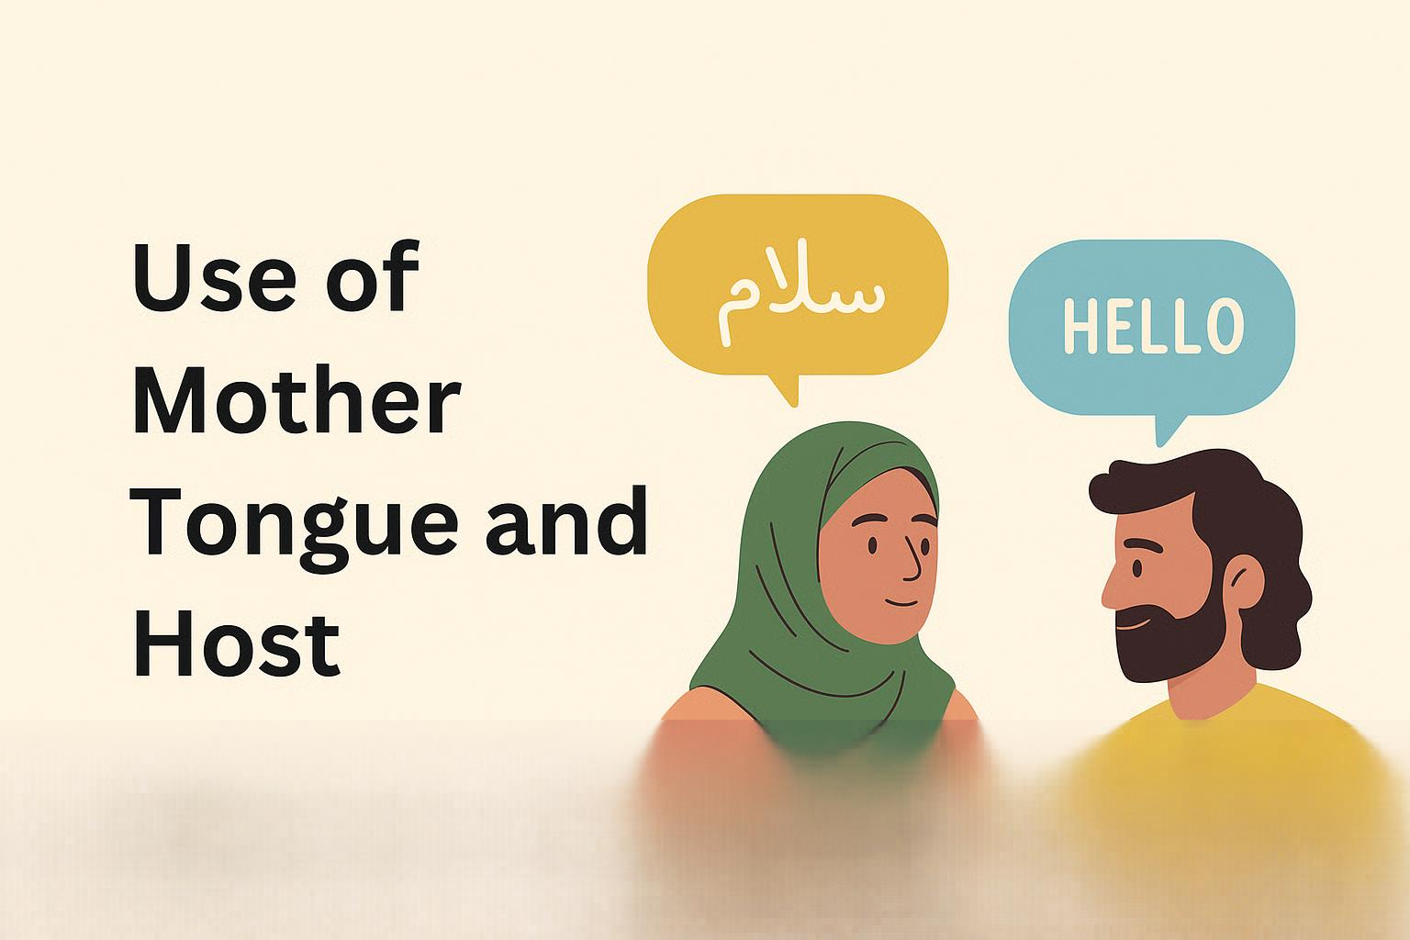
3. Use of Mother Tongue and Host Language
Provide bilingual glossaries and examples.
Allow switching between languages for understanding.
Show how both languages can work together.
  Lesson Example: Create a bilingual phrase chart: ‘څنګه يې؟ / چطور هستی؟ – Wie geht’s dir?’

Slide 5

4. Multimedia and Visuals
Include Afghan songs, videos, and crafts.
Use visuals (maps, icons, charts) for clarity.
Ensure diversity and avoid stereotypes.
  💡 Lesson Example: Watch a short video about Nowroz/EID. Compare how holidays are celebrated in both cultures.

Slide 6

5. Simple and Flexible Materials
Use plain, clear language and structure.
Offer print and digital options.
Break lessons into short modules with visuals and audio.
  💡 Lesson Example: Create a step-by-step illustrated guide for using public transport with bilingual phrases.
  Learners create maps of their neighborhood and label key places in the target language.

Slide 7

6. Peer Learning and Collaboration
Encourage group and pair work.
Let learners explain ideas in their own language first.
Promote teamwork and confidence.
  💡 Lesson Example: Groups create a shopping dialogue in Pashto/Dari, then perform it in German.

Slide 8

7. Skill Integration and Digital Literacy
Integrate listening, speaking, reading, writing.
Use digital tools (apps, messaging, maps).
Teach safe and practical online communication.
  💡 Lesson Example: Send a polite WhatsApp message to a teacher or an e-mail for making an appointment, then practice using Google Maps to find a workplace.

Slide 9

Website: WWW.Afghan-Organizations.com

